Slide 1
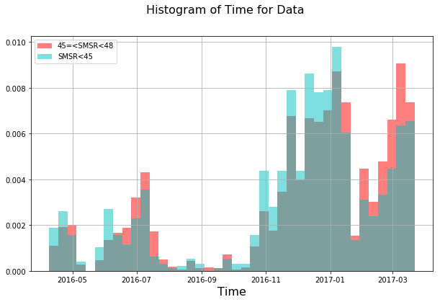
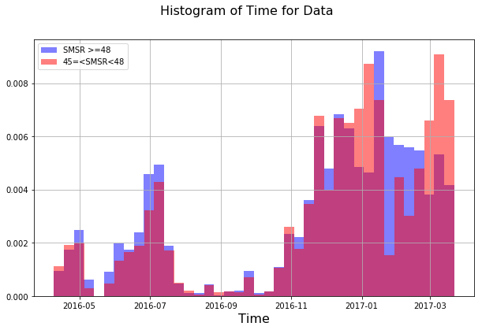
Histogram of Units with Different SMSR Categories
number of all the units = 26460,
  number of failed units = 227 (0.85 % of all the units)
number of units with SMSR >=48 = 21812, (82.43 % of all the units),
  Number of Failed Units = 110 (0.41 % of all the units )
number of units with SMSR >=45 and SMSR<48 = 3541, (13.38 % of all the units),
  Number of Failed Units = 35 (0.13 % of all the units)
number of units with SMSR <45 = 1107, (4.18 % of all the units), Number of
  Failed Units = 82 (0.30 % of all the units)
It seems like that over time, we have units from all the three categories of SMSR.

